Slide 1
Spotlight Video Recording Tips

Slide 2
Scientific Session Timeline
October 4
Spotlight Video Recording Sessions Begin
Starting in January
Spotlight Videos Released to Registrants
October
December
January
February
December 15
FINAL DAY for Spotlight Video Recording Sessions
Starting February 18
Scientific Panels
Meet Online

Slide 3
Each Scientific Session Will Have:
3 spotlight videos:
Released in January
Focusing on the individual speaker’s work
1 live virtual panel
Gathering in February
Participants will focus on how their work relates to the other panelists’ findings

Slide 4
Each Spotlight Video Will Have:
Recording of the speaker and the moderator
Conference graphics
Speaker PowerPoint slides

Slide 5
Recording Checklist:
Schedule recording session With PAVT
Scripting Your CONTENT
Powering up
Internet connection
your visuals
Your audio
Recording

Slide 6
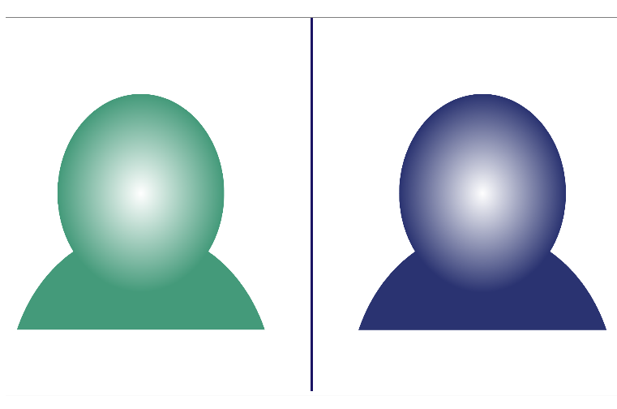
Schedule Your Recording Session
Each speaker will schedule themselves plus the moderator for one 45 min recording session with PAVT, our audio visual provider.
Calendar to select a recording timeslot can be found here- https://www.pavt.com/virtual-recordings.

Slide 7
Scripting Your Video
A video for each speaker should include:
AAAS produced intro video‐15 seconds
Moderator introduction of speaker 1 minute
Speaker presentation with slides‐10 minutes
Moderator and Speaker Q&A‐13 minutes
AAAS produced outro video‐15 seconds

Slide 8
The Moderator
For the spotlight videos, the moderator introduces each speaker, conducts the Q&A section and brings the video to a close.
For consistency, a standardized script will be made available.

Slide 9
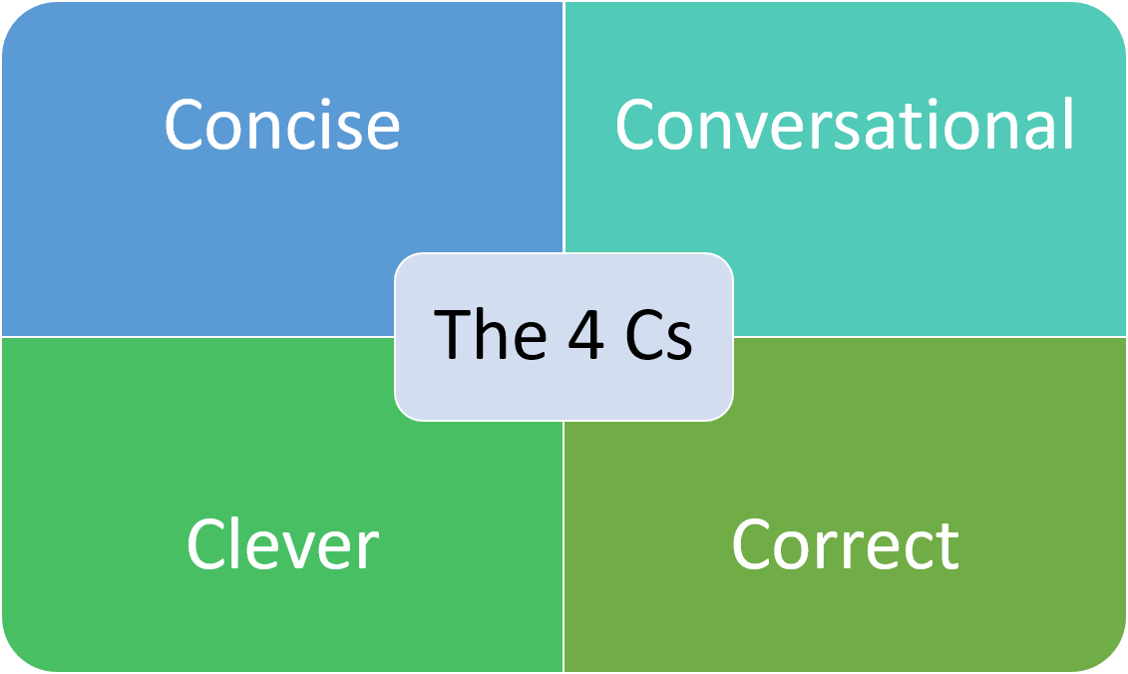
Speaker Presentation:
Focus on a few key points you want your audience to remember.
Make sure that concepts are explained for non-specialists.
Stories and analogies can illustrate key messages more clearly than overly technical information.
Be honest about the extent of your findings.

Slide 10
Preparing Your Presentation Slides
Opt for font size larger than 16 point.
Use fonts with consistently thick lines.
Provide captions for any videos shown.
Use a high color contrast for text and background of slides such as dark text on a light background.

Slide 11
Power
Connect to a power source.
Make sure your laptop/device is fully charged.
Make sure your wireless keyboard and mouse are fully charged.

Slide 12
Internet Connection
A stable, high quality internet connection is critical for your recording session with PAVT.
This will affect the quality of the presentation recording as well as captured discussion.

Slide 13
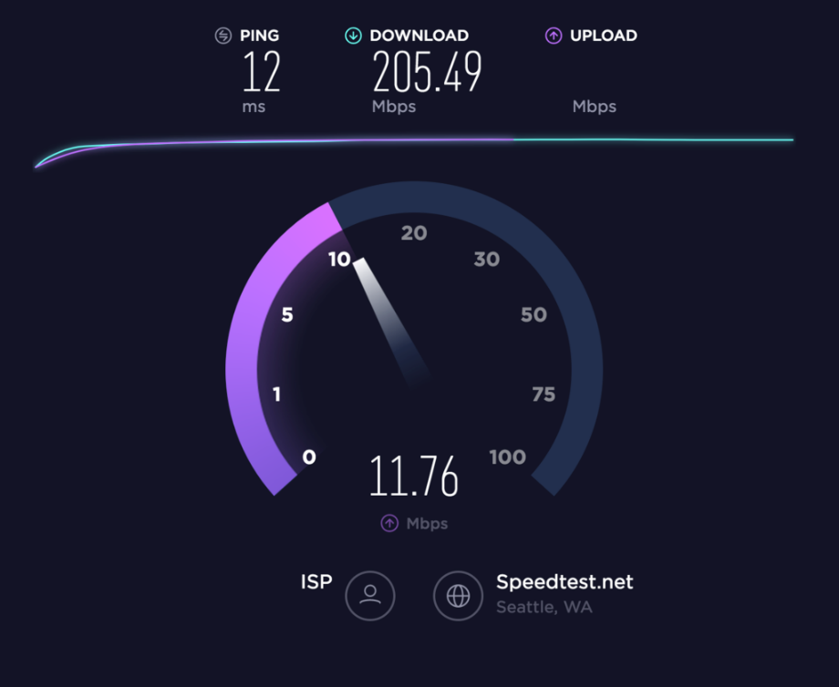
Test Internet Connection
Visit SpeedTest.com
Target speeds are the following: Download: > 5 Mbps
Upload: > 5 Mbps
For connection stability, plug your computer directly into your router using an Ethernet cable – if possible.

Slide 14
Avoiding Connection Issues
If you must use WIFI, turn off other devices that may be sharing the same signal, such as phones, tablets, and video game consoles.
Free the router – make sure it’s out of a cabinet and in an open location high in the room (not low to the ground).
Turn off all other applications on your computer that you won’t need for the virtual event.
Avoid using the microwave and other sources of electro-magnetic interference.

Slide 15
Test Microphone
Visit MicTests.com
Make sure your audio output is high quality.
Microphone should be 6-12 inches from your mouth.
A standalone microphone provides better quality than built-in computer mics.

Slide 16
NOT speaking?
MUTE yourself
And turn off ALL notifications on computer (emails, etc.)
MAC
Windows

Slide 17
Test Web Camera
Webcam Information
Webcam Name: | Integrated Camera
Quality Rating: | 281
Built-in Microphone: | None
Built-in Speaker: | None
Frame rate: | 30 FPS
Stream Type: | video
Image Mode: | rgb
Webcam MegaPixels: | 0.92 MP
Webcam Resolution: | 1280×720
Video Standard: | HD
Aspect Ratio: | 1.78
PNG File Size: | 1.71 MB
JPEG File Size: | 667.47 kB
Bitrate: | 19.65 MB/s
Number of Colors: | 70105
Average RGB Color:
Lightness: | 49.61%
Luminosity: | 50.33%
Brightness: | 49.80%
Hue: | 38°
Saturation: | 4.35%
Visit WebcamTests.com
Target/Recommended specs are the following: ▪ Stream Type: video
▪ Resolution: 1280×720
▪ Video Standard: HD
▪ Bitrate: 15 MB/s and above

Slide 18
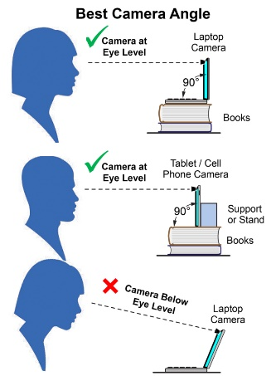
Placing Your Web Camera
Your camera should be at eye-level or slightly higher, within two feet of you for optimal framing.
Place any notes near the camera so you are not looking down reading.

Slide 19
Position Yourself
Stand up, if possible.
If you prefer to sit, lean forward.
Avoid slouching away from the camera.
Wear solid-colored clothing, avoiding green.
Try to limit the amount of room above your head.

Slide 20
Background
Try to avoid busy-looking backgrounds.
Get rid of any asymmetries or shapes that can appear to cut into your head/body.
Remove or cover distracting objects or words behind you.

Slide 21
Lighting:
Natural
Shoot in a well-lit area; if possible, find a location with access to diffuse natural light that you can control and positioned towards your face.
Avoid sunlight, which causes dramatic shadows on or washes out your face.
Prevent yourself looking silhouetted – avoid bright lights or windows behind you.

Slide 22
Lighting:
Artificial
Placing lights on both sides of computer and directed above create a studio effect.
Lighting that is LED based is preferable, it does not get too hot for the presenter to use.
Use a softened, diffused lamp (lampshades do the trick) placed at a 45° angle in front of you will eliminate most shadows on your face.

Slide 23
Before Your Recording Session
The moderator and the speaker should rehearse on their own to be prepared to go “live to tape” during their recording session.
PAVT, AAAS’ recording vendor, will send the speaker and the moderator a link to access their scheduled recording session as well as information how to submit their slides in advance.

Slide 24
Recording Day
Upon log in by the participants the PAVT Producer will
Run through a quick technical check (sound, audio, lighting)
Go over cues and slide advancement through the recording platform.
A more detailed instructional video on the recording session will be available in mid-September.

Slide 25
Lights, Camera, Action!
When recording:
Speak as if you are presenting to a live audience.
Avoid speaking too quickly or in a monotone voice.
Make sure to pause after explaining each visual so that individuals will have a chance to process the information.
Gesture purposefully for emphasis.

Slide 26
Thank you in advance for your time, energy and contribution to the AAAS 2022 Annual Meeting.
If you need further assistance, please contact us at meetings@aaas.org

